Slide 1
Wifi Nâng cao

Slide 2
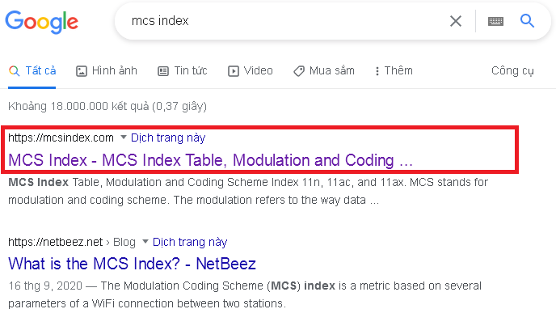

Slide 3
MCS Table

Slide 4
Google: MCS Index RSSI

Slide 6
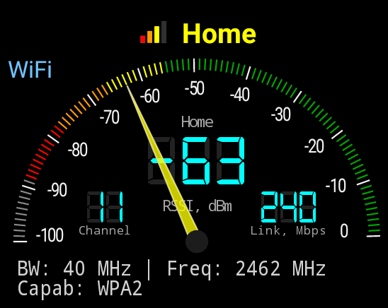
Cell Info Lite
Info from chipset

Slide 7
Chipset: Realtek 1G Wifi 5
Tenda AC5 V3
Tenda AC8
Netis N5

Slide 8
Mediatek MT7628: 580 MHz
Xiaomi 4A Nội địa
TPLINK C50

Slide 9
TP-Link C60

Slide 10
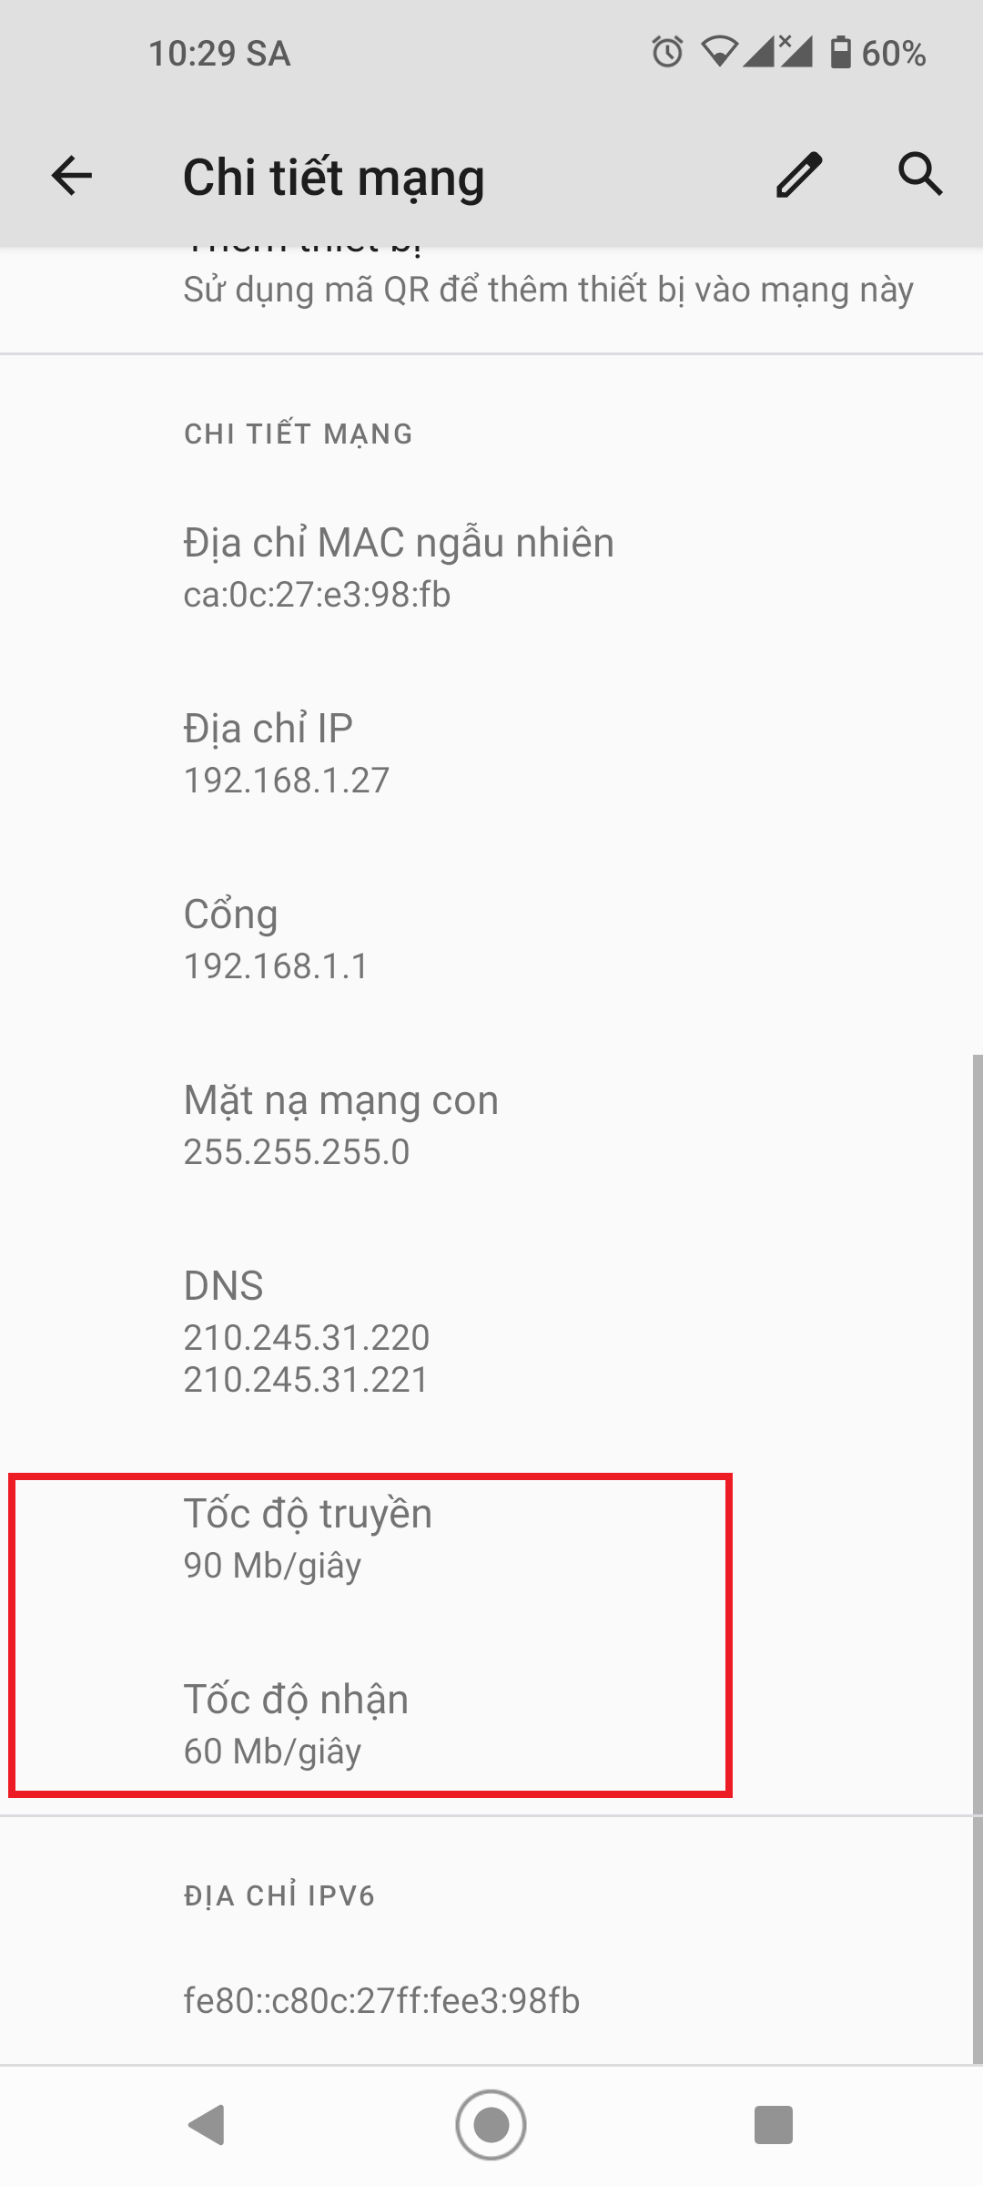

Slide 11
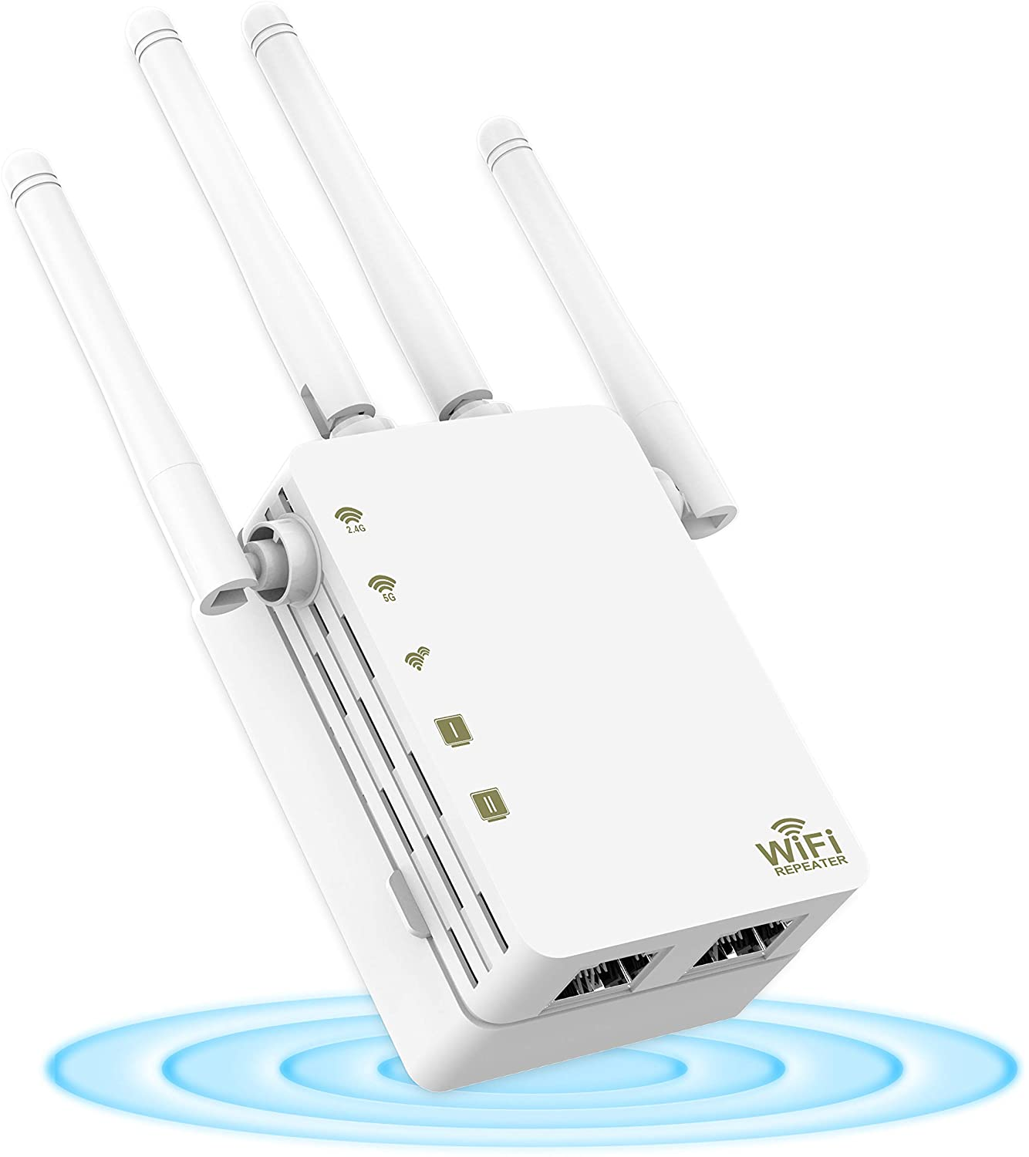
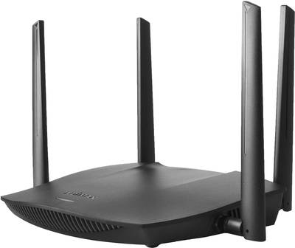
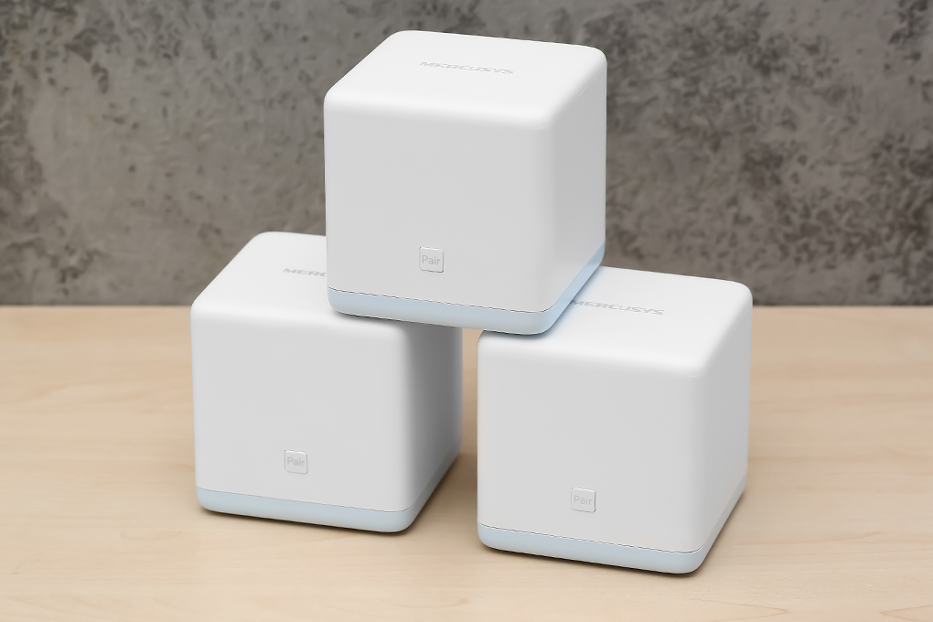
Wifi variants

Slide 12
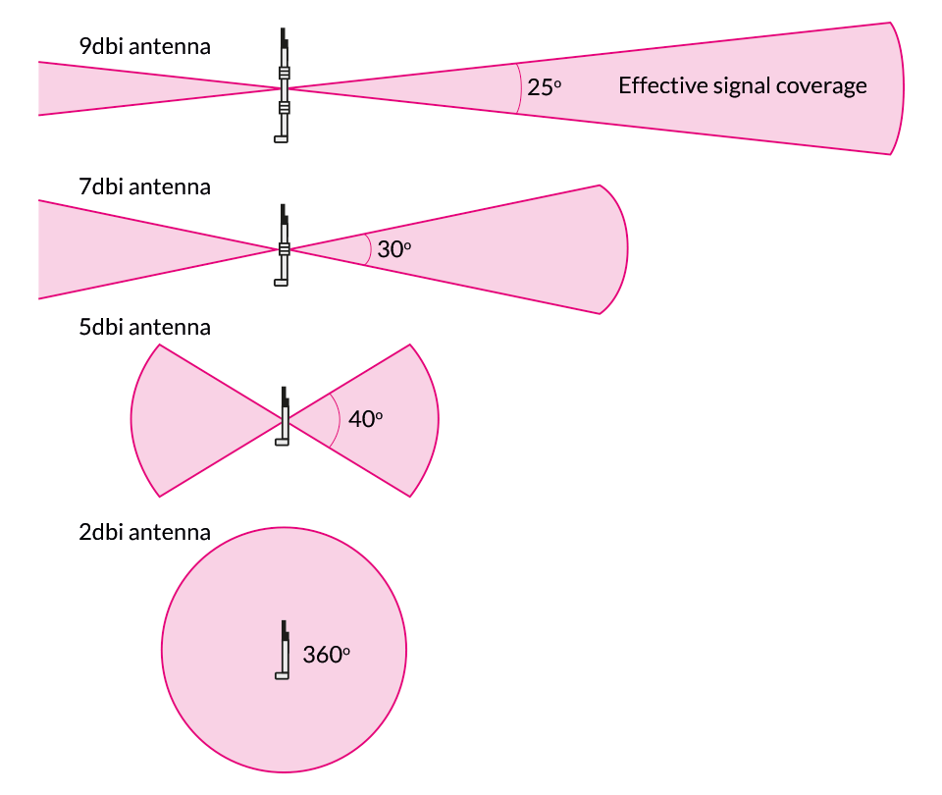
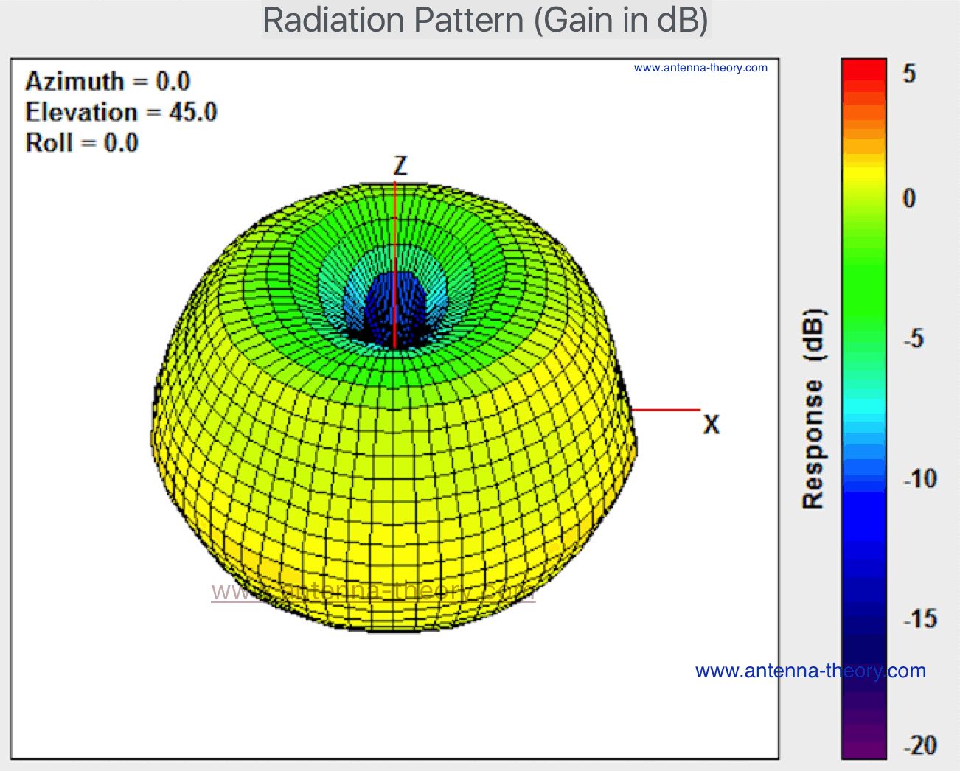
Wifi antenna

Slide 15
Mesh
802.11s : Mesh routing protocol
WDS
Client Bridge

