Slide 1
Wifi basic

Slide 2
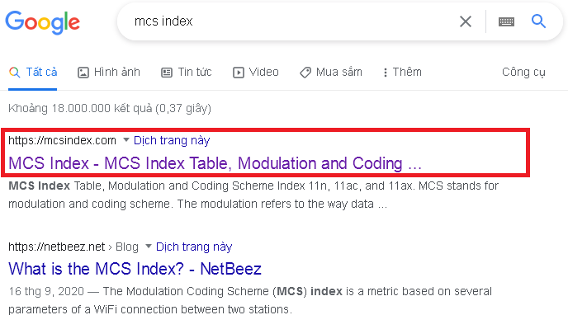

Slide 3
MCS Table

Slide 4
Google: MCS Index RSSI

Slide 6
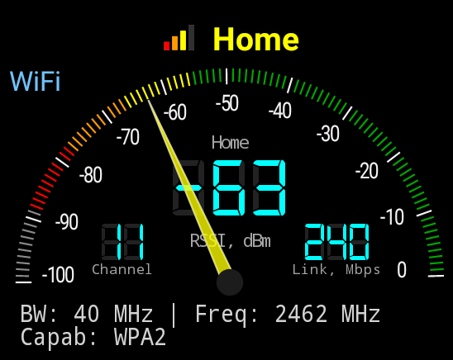
Cell Info Lite
Info from chipset

Slide 7
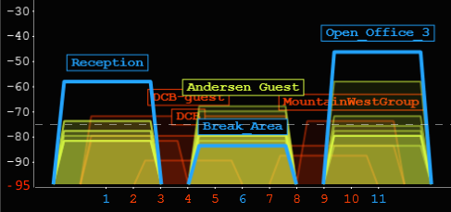
Wifi Analyzer
Wifi scan

Slide 8
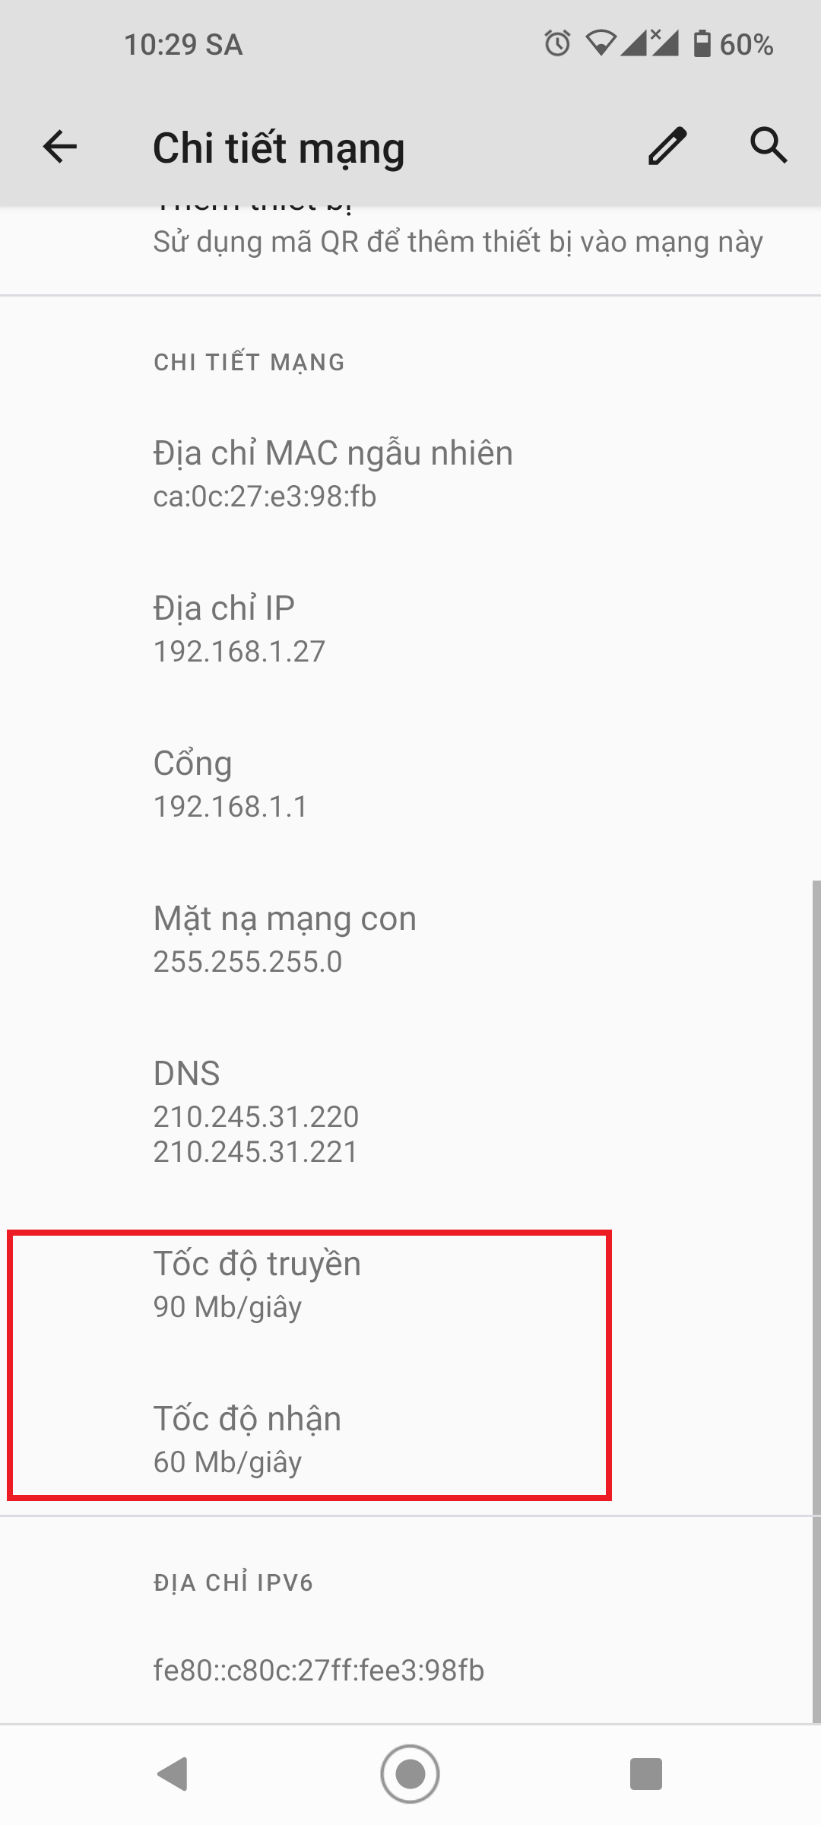

Slide 9
Wifi Speed
 | Theoretical | Actual
802.11b | 11 Mbps | 5.5 Mbps
802.11a | 54 | 20
802.11g | 54 | 20
802.11n | 600 | 100
802.11ac | 1300 | 200
802.11ax | 10 Gbps | 2 Gbps

Slide 10
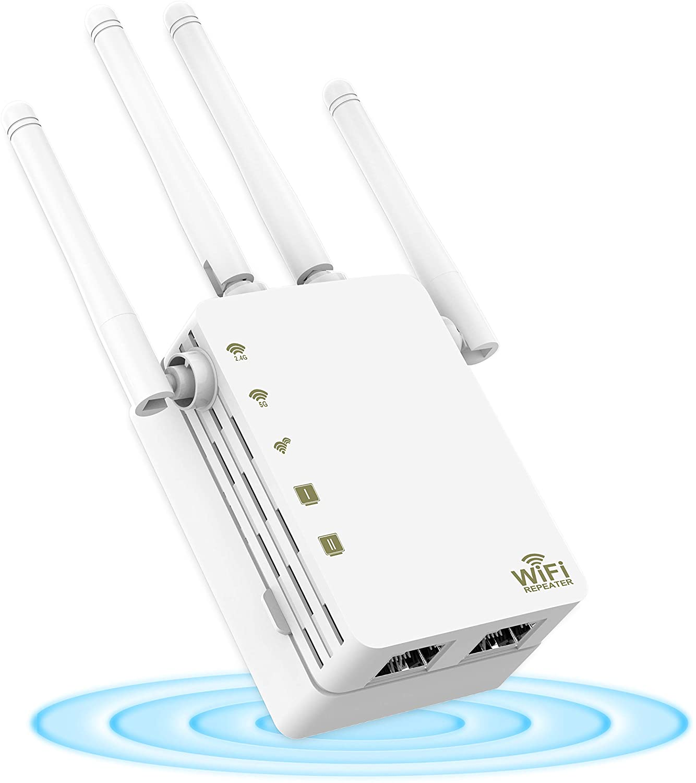
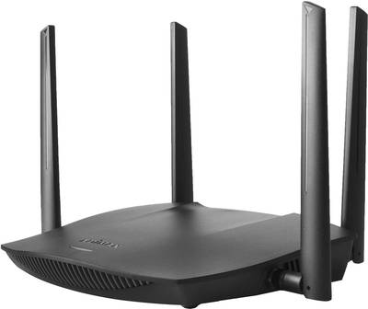
Wifi variants

Slide 11
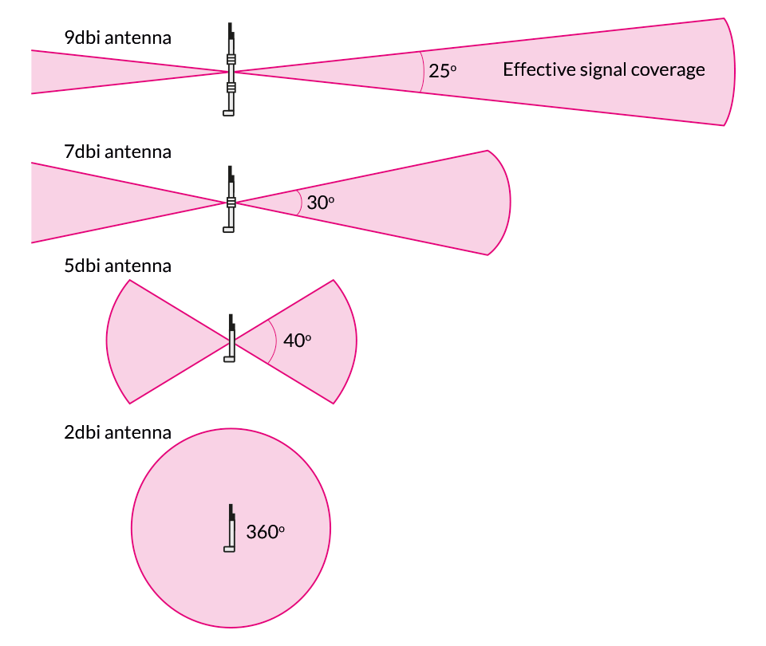
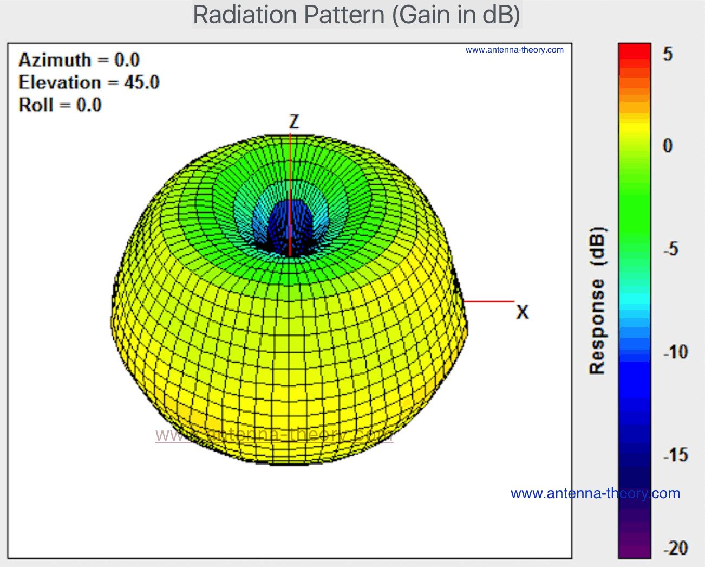
Wifi antenna

Slide 13
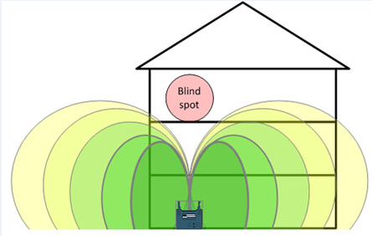

Slide 14
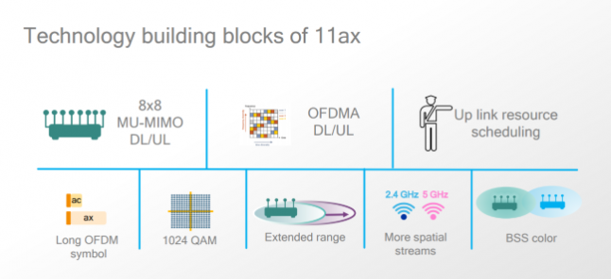
Wifi 6: 802.11ax

Slide 15
Wifi chipsets
Qualcomm
Realtek
Mediatek Ralink

Slide 16
Wifi router as a Computer
Linux 2.6 or higher
Drivers: wifi, switch, GPIO
Antenna

Slide 17
Mesh
802.11s : Mesh routing protocol
WDS
Client Bridge

