Slide 1
WIFI ROUTER GAMING CONFIG

Slide 2
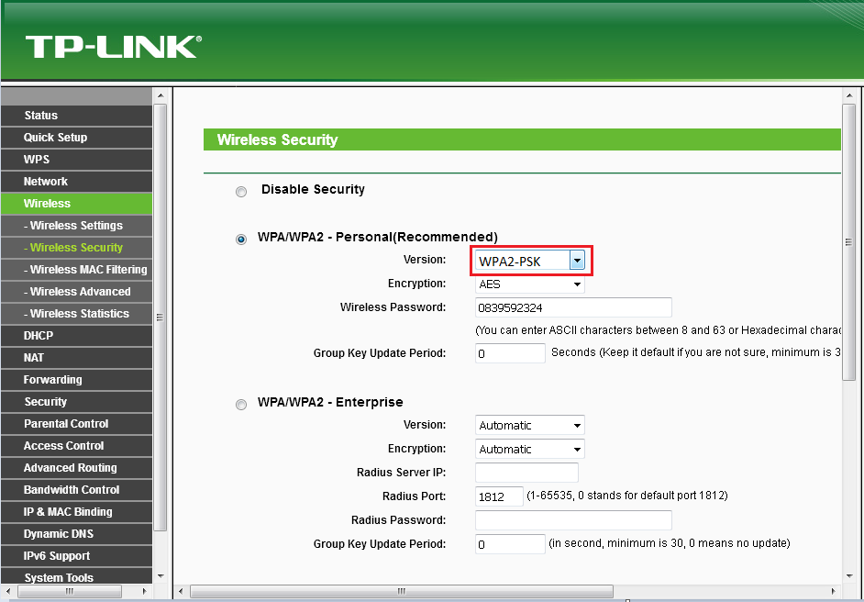
1. Wireless Security
- Wireless => Wireless Security
- WPA/WPA2 – Personal => Version => WPA2 – PSK
2

Slide 3
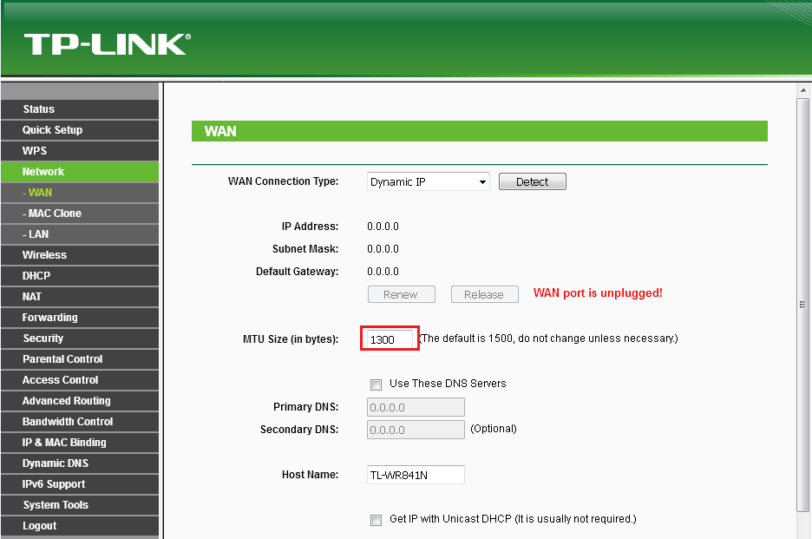
2. Network WAN
- Network => Wan
- MTU Size (in bytes) = 1300
3

Slide 4
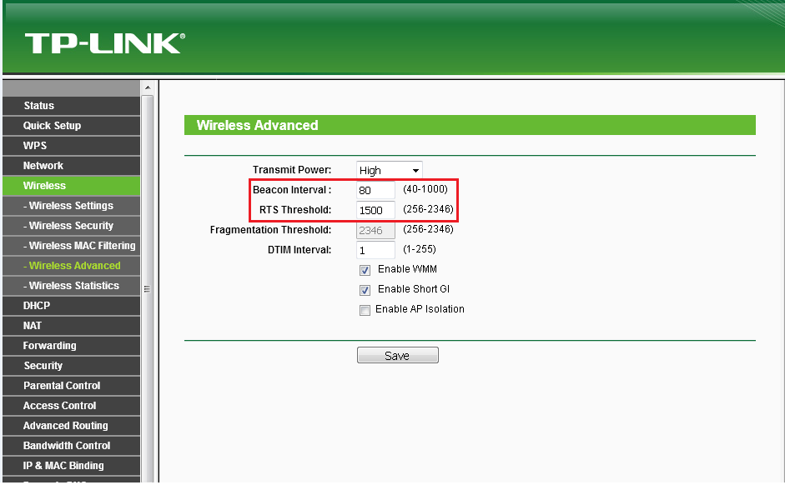
3. Wireless Advanced
- Wireless => Wireless Advanced
- Beacon Interval = 80; RTS Threshold = 1500
4

Slide 5
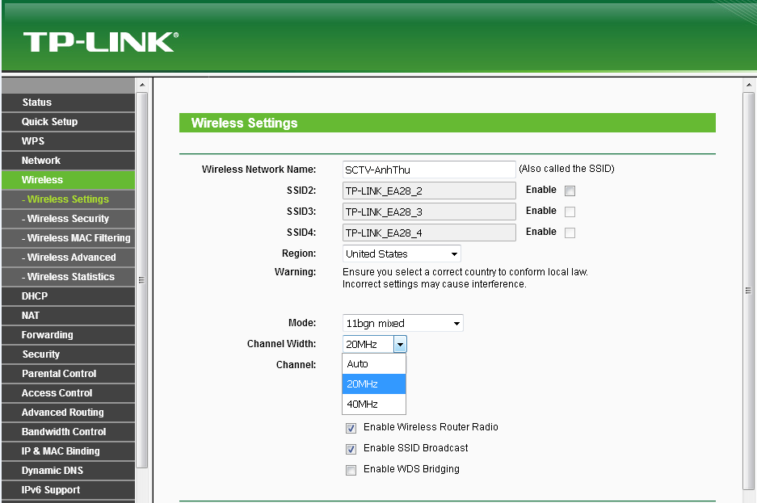
4. Wireless Setting
- Wireless => Wireless Setting
- Channel = 20MHz
5

Slide 6
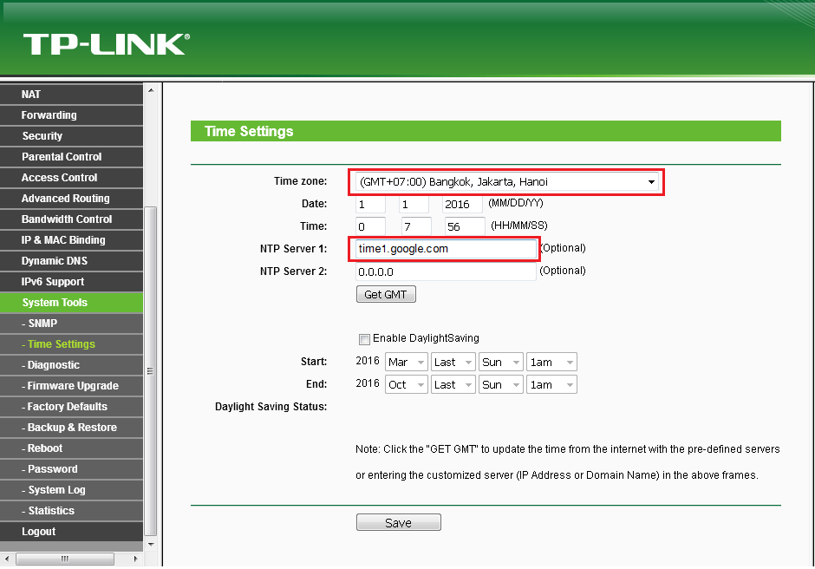
4. Wireless Setting
- Time zone => GMT +7:00
- NTP Server = time1.google.com
6

Slide 7
Thank you!
7

Slide 8
DD-WRT FIRMWARE UPDATE FOR WR TPLINK 841N

Slide 9
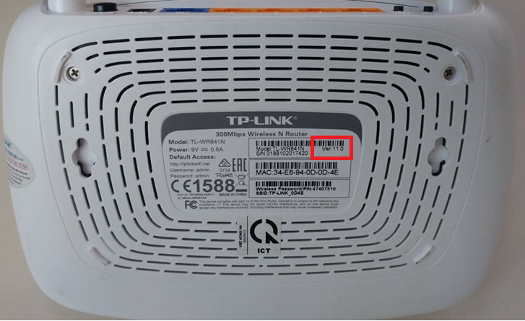
1. Version WR
- Kiểm tra version WR để chọn file firmware update cho phù hợp
- Link download: http://sce.sctv.net.vn/downloads/TPLink/841N/
9

Slide 10
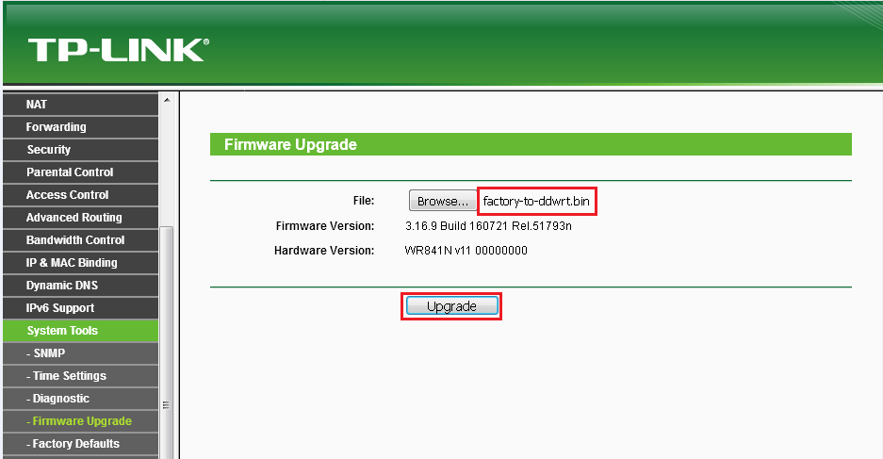
2. Upgrade lần 1
- Chọn file “factory-to-ddwrt.bin”
=> “Upgrade”
10

Slide 11
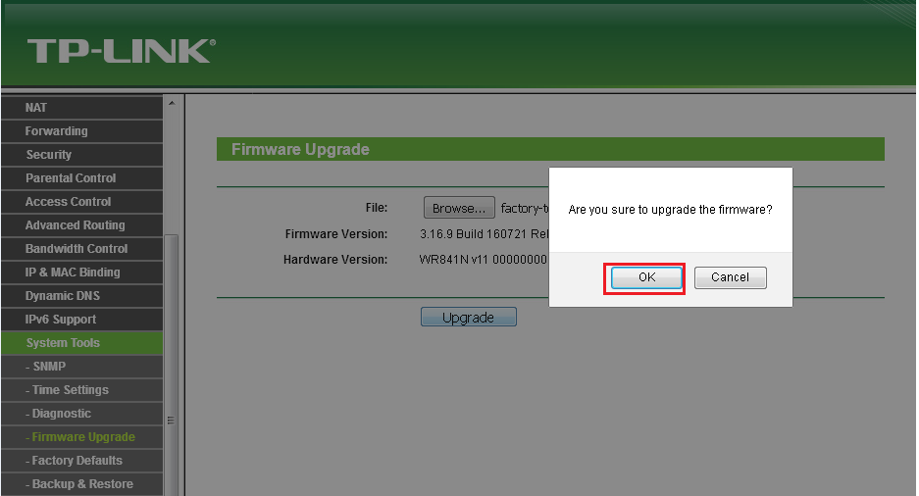
2. Upgrade lần 1
=> Cofirm “OK”
11

Slide 12
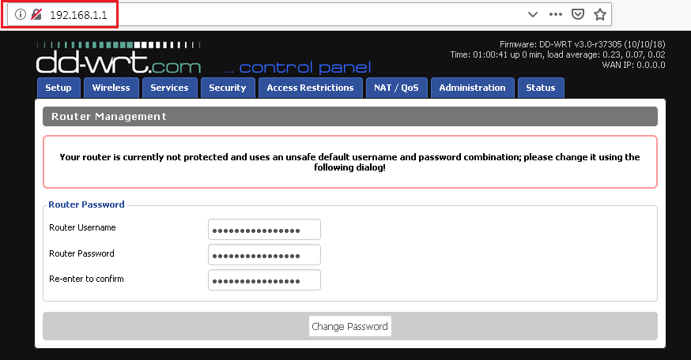
2. Upgrade lần 1
- “Không reset power”.
- Sau 300s thay đổi local IP = 192.168.1.1 để vào giao diện mới của WR
- Account login nếu có = admin/admin
12

Slide 13
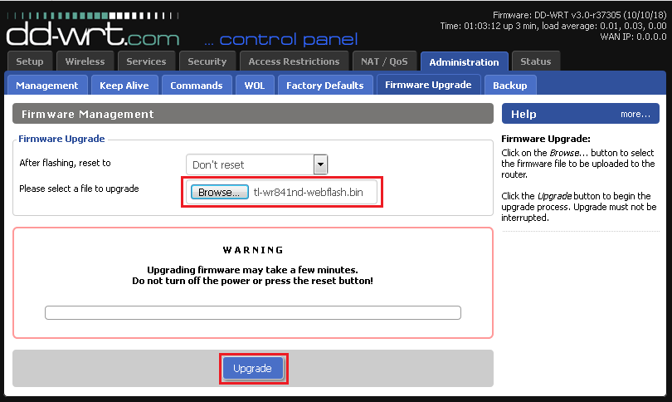
2. Upgrade lần 2
- Administrator => Firmware Upgrade
- Chọn file “tl-wr841nd-webflash.bin”
=> “Upgrade”
13

Slide 14
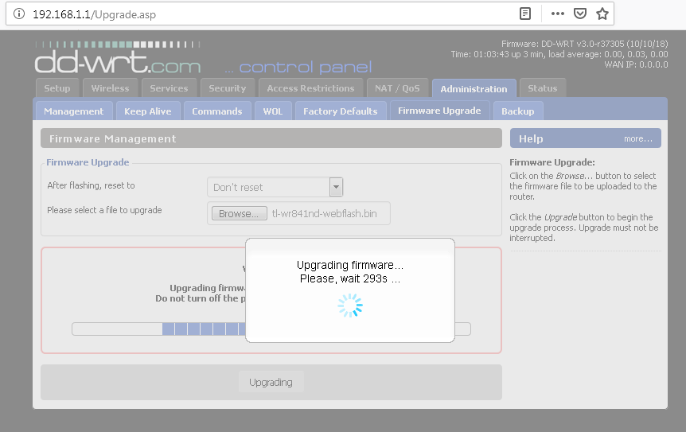
2. Upgrade lần 2
- Upgrading.
14

Slide 15
2. Upgrade lần 2
- Successful and rebooting.
15

Slide 16
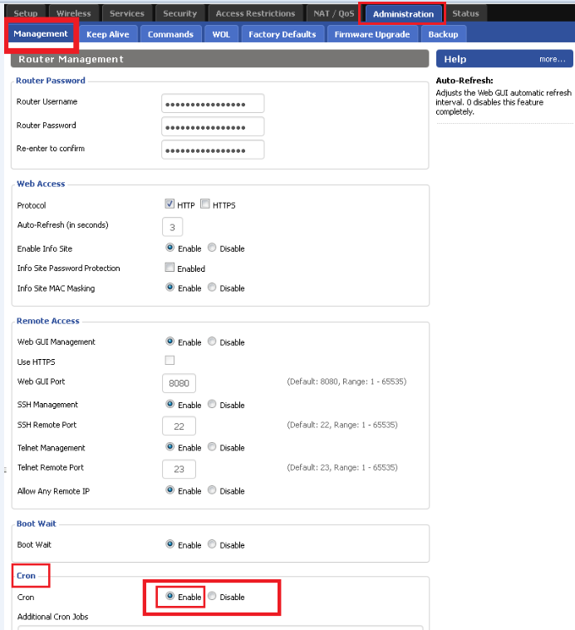
3. Auto Reboot WR
Administrator => Management => Cron => Enable
16

Slide 17
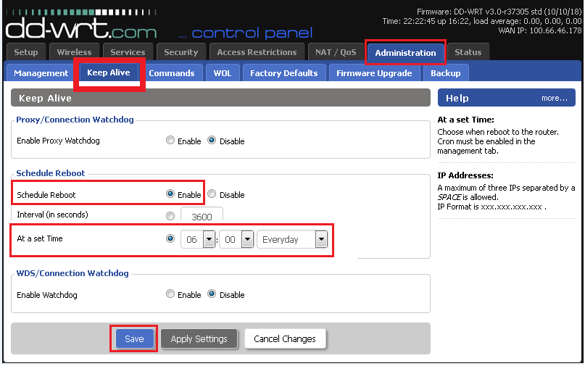
3. Auto Reboot WR
- Administrator => Keep Alive => Schedule Reboot => Enable
- At a set Time => chọn thời điểm và chu kì Reboot.
17

Slide 18
Thank you!
18

